Slide 1
Lecture schedule October 3 – 7, 2011
Heavy Fermions
#1 Kondo effect
#2 Spin glasses
#3 Giant magnetoresistance
#4 Magnetoelectrics and multiferroics
#5 High temperature superconductivity
#6 Applications of superconductivity
#7 Heavy fermions
#8 Hidden order in URu₂Si₂
#9 Modern experimental methods in correlated electron systems
#10 Quantum phase transitions
Present basic experimental phenomena of the above topics
Present basic experimental phenomena of the above topics

Slide 2
Heavy Fermions: Experimentally discovered -- CeAl₃ (1975), CeCu₂Si₂ (1979) and Ce(Cu_{6-x} Au_{x}) (1994) At present not fully explained theoretically
Large effective mass - m*
Loss of local moment magnetism
Large electron-electron scattering
Renormalized heavy Fermi liquid
Unconventional superconductivity from heavy mass of f-electrons
Other unusual ground state properties appearing out of heavy Fermi liquid, e.g., reduced moment antiferromagnetism, hidden order; quantum phase transitions.
Various phenomenological theories and models.
Example of strongly correlated electrons systems (SCES).

Slide 3
What are SCES: An experimentalist’s sketch
H = KE + {U,V,J,Δ}, Bandwidth (W) vs interactions
e.g., H = ∑ t _{ij} c†_{i,σ} c_{j,σ} + U ∑ n_{i↑} n _{i↓} Hubbard Model
If {U,V,J,Δ} >> W, then SCES, e.g. Mott-Hubbard insulator.
See sketch. What type of systems ? TM oxides.
H = KE + H_{K} + H_{J} , Bandwidth (W) vs interactions
e.g., H = ∑ ε_{k} c†_{k} c_{k} + J_{K}∑S_{r}·(c†σc) + J_{H}∑ S_{r} · S_{r’}
Kondo/Anderson Lattice Model
If {J_{K},J} >> ε_{k} (W), then SCES, e.g. HFLiq, NFL, QCPt.
See sketches. What type of systems ? 4f &5f intermetallics.

Slide 4
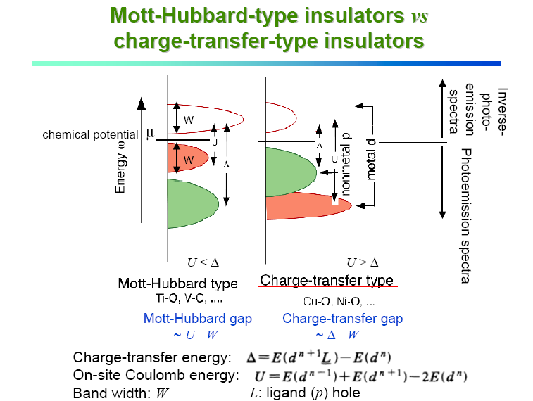

Slide 5
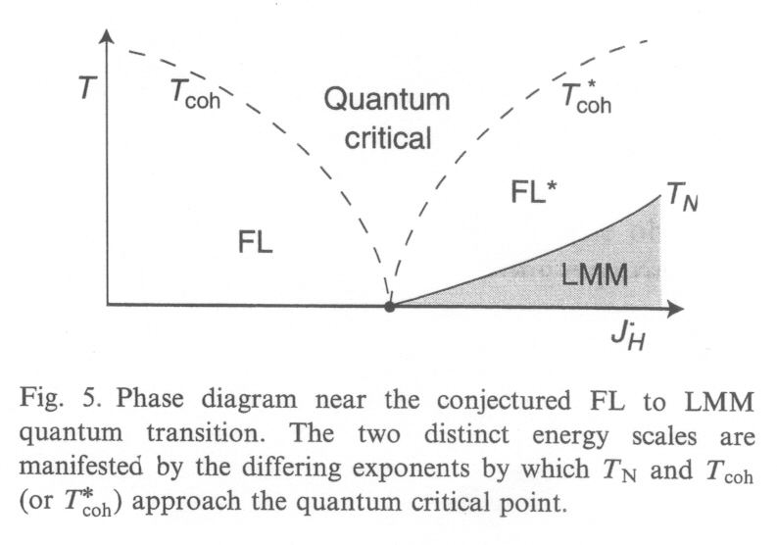
Metallic systems: Temperature vs J_{H}. Unconventional Fermi liquids to local moment (antiferro)magnetism.
J
Senthil, S. Sachdev & M. Vojta, Physica B 359-361,9(2005)

Slide 6
Metallic systems: Temperatute vs J_{K}. Unconventional Fermi liquid to Kondo state - conventional FL.
Novel U(1)FL* fractionalized FL with deconfined neutral S=1/2 excitations. U(1) is the spin liquid gauge group. <b> (slave boson) measures mixing between local moments and conduction electrons.
Theoretical Proposal from T. Senthil et al. PRB (2004).

Slide 7
Generic magnetic phase diagram resulting from HFLiq.
tunable ground state properties ⇒ control parameter δ
δ
experimental:
pressure
δ
magnetic hybrid. strength J
δ
experimental:
mag. field
pressure
substitution
SC
unconventional superconductivity/novel phases
quantum critical behavior (Non-Fermi-Liquid)
ultra-low moment magnetism / “Hidden Order“

Slide 8
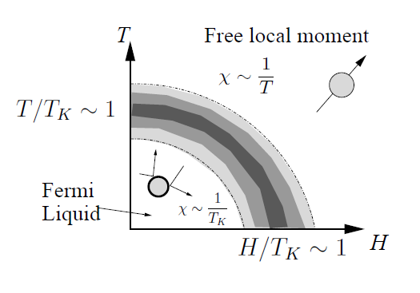
How to create a heavy fermion? Review of single-ion Kondo effect in T – H space.
(Note single impurity Kondo state is a Fermi liquid!)
Crossover in H & T

Slide 9
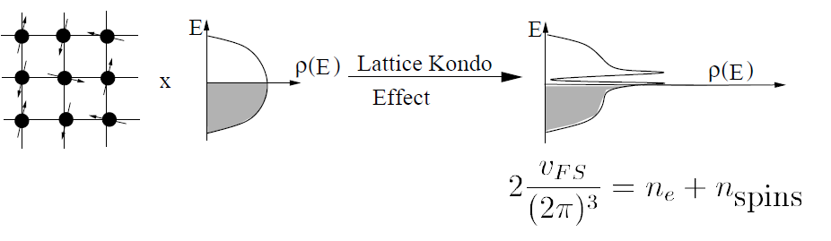
Now the Kondo lattice DOS with FS volume increased
Possibility of real phase transitions
“Kondo insulator” small energy gap in DOS at E_{F}

Slide 10
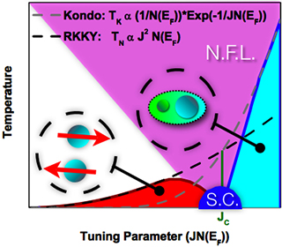
Cartoon of Doniach phase diagram (1976):
Kondo vs RKKY on lattice

Slide 11
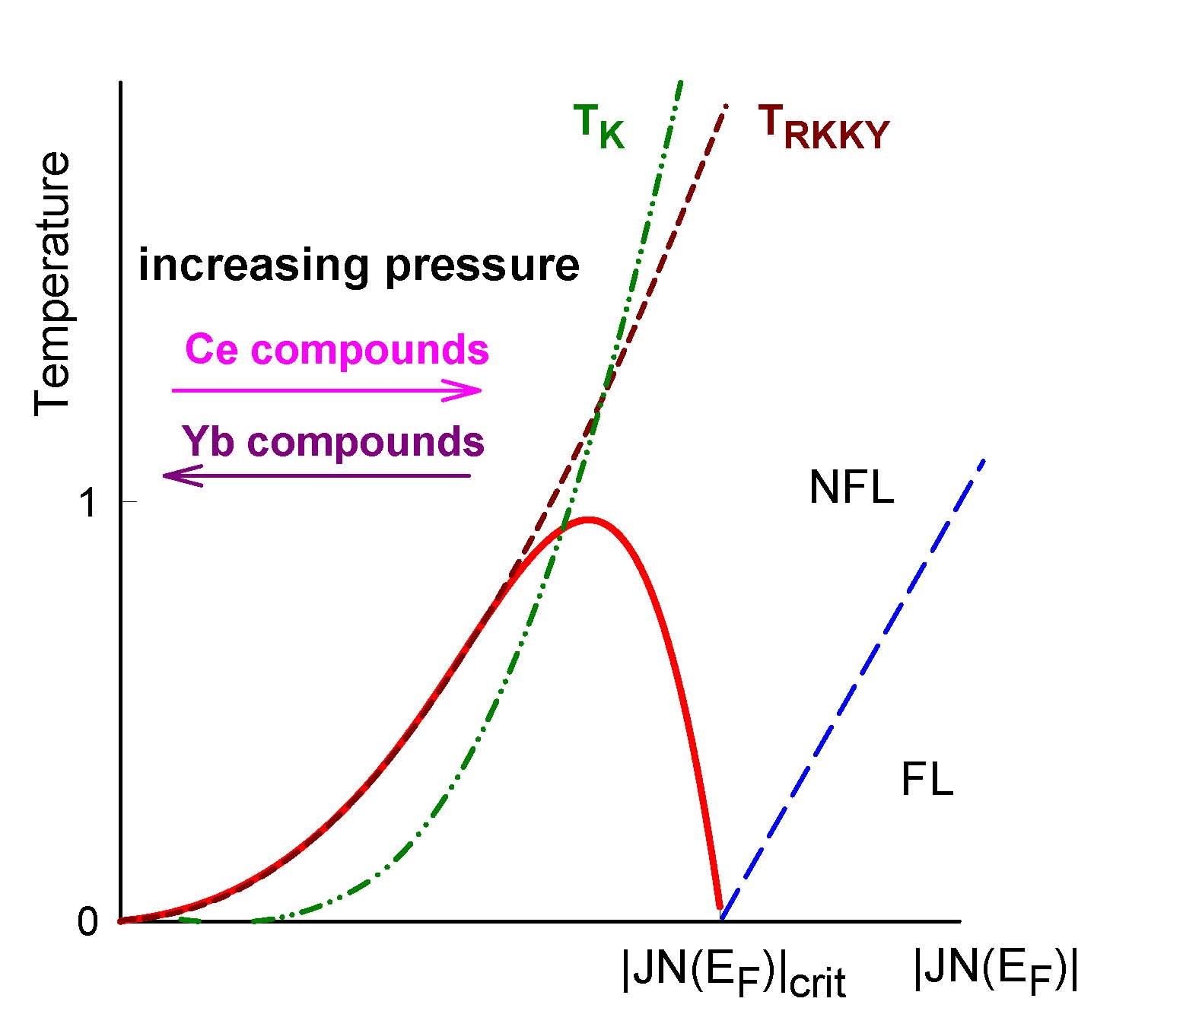
Doniach phase diagram can be pressure tuned
U-based compounds ???

Slide 12

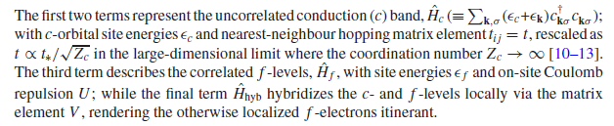
Instead of single impurity Anderson or Kondo models, need periodic Anderson model (PAM) – not yet fully solved
Note summation over lattice sites: i and j

Slide 13
Extension of our old friend the single imputity Anderson model to the Anderson/Kondo lattice. Now PAM
Nice to have Hamiltonian but how to solve it? Need variety of interactions: c-c, c-f; f-f which are non-local, i.e., itinerant – band structure.

Slide 14
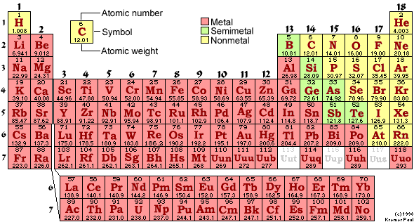
Elements with which to work and create HFLiq.
Mostly METALS, almost all under pressure superconducting ! Consider SCES that are intermetallic compounds, “Heavy Fermions”.

Slide 15
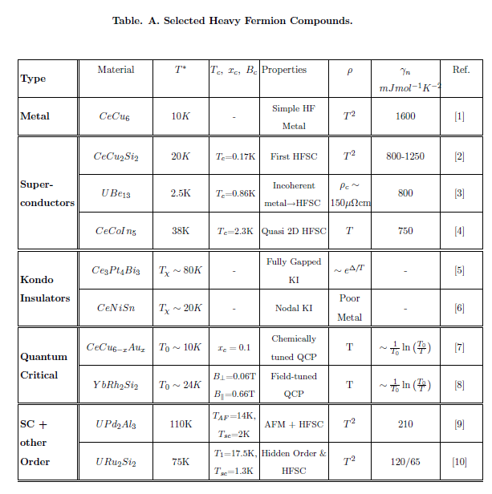

Slide 16
Basic properties of HF’s. For an early summary, see G.R. Steward, RMP 56(1984), 755.
Specific heat and susceptibility (as thermodynamic properties), and resistivity and thermopower (as transport properties) with m* as renormalized effective mass due to large increase in density of states at E_{F}.
T* represents a crossover “coherence” temperature where the magnetic local moments become hybridized with the conduction electrons thereby forming the heavy Fermi liquid. (Sometimes called the Kondo lattice temperature).
Key question here is what forms in the ground state T → 0: a vegetable (heavy spin liquid), e.g. CeAl₃ or CeCu₆, or something more interesting.
What is the mechanism for the formation of heavy Fermi liquid: Kondo effect with high T quenching of Ce, Yb; U moments or strong hybridization of these moments with the itinerant conduction electrons?

Slide 17
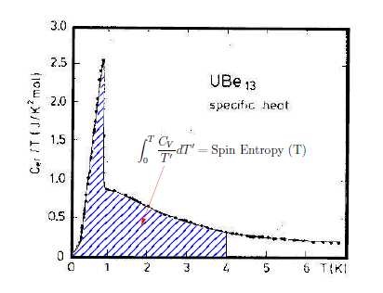
C_{V}/T vs T showing the spin entropy for UBe₁₃. Note the dramatic superconducting transition at T_{C} = 0.9K and the large γ-value (1 J/mole-K²) for T>T_{C}
Fall-off of C/T into superconducting state – power laws: nodes in SC gap

Slide 18
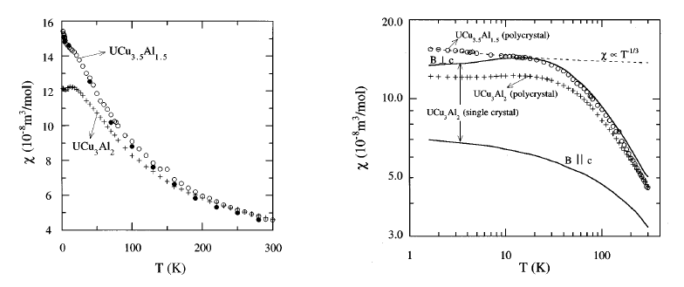
Susceptibility – enhanced yet constant at lowest temperatures, problems with residual impurities.
Not Curie-Weiss-like!
χ → constant as T → 0 (enhanced Pauli-very large DOS at E_{F}) but band structure effects intervene at low temperatures creating maxima.

Slide 19
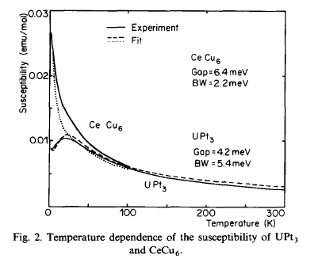
More susceptibility: CeCu₆ (HFLiq) and UPt₃ (HF-SC,
T_{C} = 0.5K). Note ad-hoc fit attempts of χ(T)

Slide 20
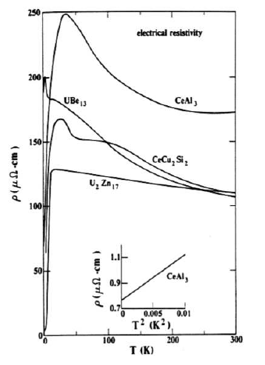
Collection of resistivity vs T data for various HF’s
Note large ρ(T) at hiT[large spin fluc./Kondo scattering] and lowT ρ(T) = ρ_{o} + AT² [heavy Fermi liquid state with large A-coefficient.]

Slide 21
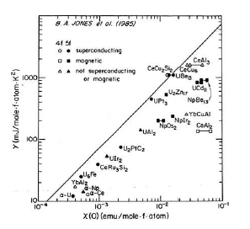
Relations between the three experimental parameters γ, χ, and ρ in HFLiq. State: Wilson ratio
Wilson ratio of low T susceptibility to specific heat coefficient.
Directly follows from Fermi liquid theory with large m*

Slide 22
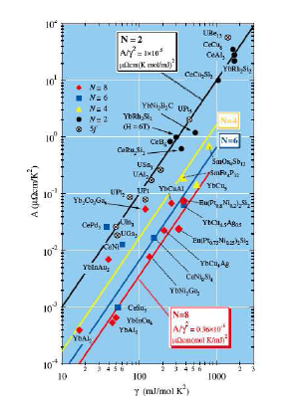
Kadowaki – Woods ratio: γ²/A = const(N). Complete collection of HF materials. Note slope = 2 in log/log plot
Recent theory can account for different N-values

Slide 23
Extended Drude model for heavy fermions to analyze optical conductivity measurements
σ(ω) = ω_{p}/[4π(τ⁻¹ – iω)] where σ = σ₁ + iσ₂
ω_{p} = 4πne²/m
σ₁ = ω_{p}τ⁻¹/[4π(τ⁻² + ω²)]
σ₂ = ω_{p}²ω/[4π(τ⁻² + ω²)]
1/τ(ω) = ωσ₁(ω)/σ₂(ω) = [ω_{p}(ω)/4π]Re[1/σ(ω)]
1/ω_{p}²(ω) = [1/4πω]Im[-1/σ(ω)]
For mass enhancement: m*/m = 1 + λ
τ(ω) = (m*/m)τ_{o}(ω) = [1 + λ(ω)]τ_{o}(ω) and ω_{p}²(ω) = ω_{p}²/[1 + λ]
1 + λ(ω) = [ω_{po}²/4πω]Im[-1/σ(ω)
Fermi liquid theory: 1/τ_{o}(ω) = a (ħω/2π)² + b(k_{B}T)²
where b ≈ 4 old Fermi liquid theory and b ≈ 1 for some new heavy fermions

Slide 24
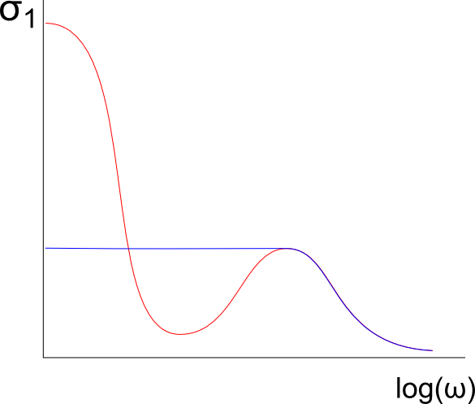
Optical conductivity σ(ω) of generic heavy fermion:
T > T* and T < T* formation of hybridization gap, i.e., a partial gapping usually called pseudo gap.
T < T*: large Drude peak
σ(ω) = (ne²/m*) [τ*/(1 + ω²τ*²]
1/τ* = m/(m*τ) renormalized effective mass & relaxation rate
T > T*
Hybridization gap
Note shifting of spectral weight from pseudo gap to large Drude peak

Slide 25
New physics with disorder: The magnetic phase diagram of heavy fermions (phenomenologically). Pressure vs disorder and non Fermi liquids (NFL).
inequivalent
control parameters
pressure = J
chem. pressure
≠
disorder = ΔJ
substitution
disorder and NFL behavior?
substitutional disorder?

Slide 26
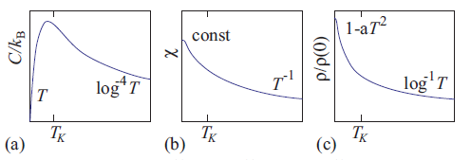

Non Fermi liquid behavior: What is it ??? Previously used term “quantum critical” in vicinity (above) of QCP
HFLiq.renormal-ized by m*: ρ = ρ_{o} + AT²
Deviations from above FL behavior
NFL →
More in #10 Quantum Phase Transitions

Slide 27
STOP

Slide 28

New physics: the magnetic phase diagram of heavy fermions (phenomenologically)
inequivalent
control parameters
pressure = J
chem. pressure
≠
disorder = ΔJ
substitution
disorder and NFL behavior?
substitutional disorder?

Slide 29
Generic magnetic phase diagram
tunable ground state properties ⇒ control parameter δ
δ
experimental:
pressure
δ
magnetic hybrid. strength J
δ
experimental:
mag. field
pressure
substitution
SC
unconventional superconductivity/novel phases
quantum critical behavior (Non-Fermi-Liquid)
ultra-low moment magnetism / “Hidden Order“

Slide 31
Lecture schedule October 3 – 7, 2011
#1 Kondo effect
#2 Spin glasses
#3 Giant magnetoresistance
#4 Magnetoelectrics and multiferroics
#5 High temperature superconductivity
#6 Applications of superconductivity
#7 Heavy fermions
#8 Hidden order in URu₂Si₂
#9 Modern experimental methods in correlated electron systems
#10 Quantum phase transitions
Present basic experimental phenomena of the above topics
Present basic experimental phenomena of the above topics

Slide 32
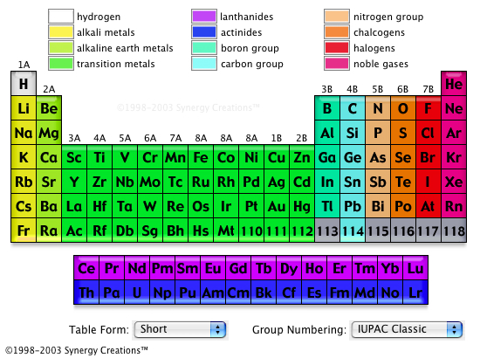
Elements with which to work

Slide 33
What are SCES ?
H = KE + {U,V,J,Δ}, Bandwidth (W) vs interactions
e.g., H = ∑ t _{ij} c†_{i,σ} c_{j,σ} + U ∑ n_{i↑} n _{i↓} Hubbard Model
If {U,V,J,Δ} >> W, then SCES, e.g. Mott-Hubbard insulator.
See sketch. What type of systems ? TM oxides.
H = KE + H_{K} + H_{J} , Bandwidth (W) vs interactions
e.g., H = ∑ ε_{k} c†_{k} c_{k} + J_{K}∑S_{r}·(c†σc) + J∑ S_{r} · S_{r’}
Kondo Lattice Model
If {J_{K},J} >> ε_{k} (W), then SCES, e.g. HFLiq, NFL, QCPt.
See sketches. What type of systems ? 4f &5f intermetallics.

